Slide 1
CSS Flexbox

Slide 2
CSS Flexbox Layout Module
Before the Flexbox Layout module, there were four layout modes:
Block, for sections in a webpage
Inline, for text
Table, for two-dimensional table data
Positioned, for explicit position of an element
The Flexible Box Layout Module, makes it easier to design flexible responsive layout structure without using float or positioning.

Slide 3
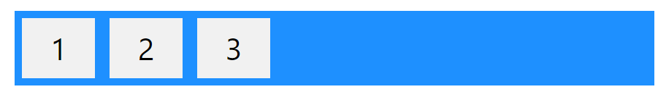
Flexbox Elements
To start using the Flexbox model, you need to first define a flex container.
The element above represents a flex container (the blue area) with three flex items.
A flex container with three flex items:
<div class="flex-container"> <div>1</div> <div>2</div> <div>3</div> </div>

Slide 4
CSS Flex Container Parent Element (Container)
Like we specified in the previous, this is a flex container (the blue area) with three flex items:
The flex container becomes flexible by setting the display property to flex:
.flex-container { display: flex; }

Slide 5
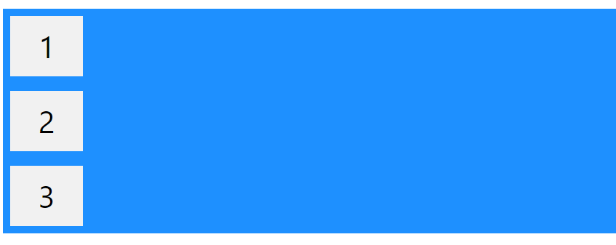
The flex-direction Property
The flex-direction property defines in which direction the container wants to stack the flex items.
.flex-container { display: flex; flex-direction: column; }

Slide 6
The column-reverse value stacks the flex items vertically (but from bottom to top):
.flex-container { display: flex; flex-direction: column-reverse; }
The row value stacks the flex items horizontally (from left to right):
.flex-container { display: flex; flex-direction: row; }

Slide 7
The row-reverse value stacks the flex items horizontally (but from right to left):
.flex-container { display: flex; flex-direction: row-reverse; }

Slide 8
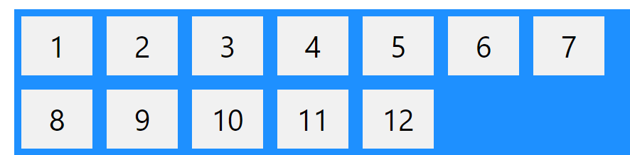
flex-wrap Property
The flex-wrap property specifies whether the flex items should wrap or not.
The examples below have 12 flex items, to better demonstrate the flex-wrap property.
.flex-container { display: flex; flex-wrap: wrap; }
.flex-container { display: flex; flex-wrap: nowrap; }
.flex-container { display: flex; flex-wrap: wrap-reverse; }

Slide 9
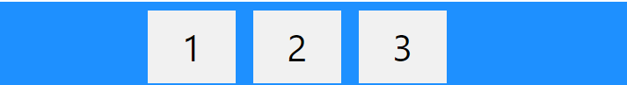
The justify-content Property
The justify-content property is used to align the flex items:
The center value aligns the flex items at the center of the container:
.flex-container { display: flex; justify-content: center; }
The flex-start value aligns the flex items at the beginning of the container (this is default):
.flex-container { display: flex; justify-content: flex-start; }

Slide 10
The flex-end value aligns the flex items at the end of the container:
.flex-container { display: flex; justify-content: flex-end; }
The align-items property is used to align the flex items.
The center value aligns the flex items in the middle of the container:
.flex-container { display: flex; height: 200px; align-items: center; }

Slide 11
The flex-start value aligns the flex items at the top of the container:
.flex-container { display: flex; height: 200px; align-items: flex-start; }
The flex-end value aligns the flex items at the bottom of the container:
.flex-container { display: flex; height: 200px; align-items: flex-end; }
The stretch value stretches the flex items to fill the container (this is default):
.flex-container { display: flex; height: 200px; align-items: stretch; }

Slide 12
The CSS Flexbox Container Properties
Property | Description
align-content | Modifies the behavior of the flex-wrap property. It is similar to align-items, but instead of aligning flex items, it aligns flex lines
align-items | Vertically aligns the flex items when the items do not use all available space on the cross-axis
display | Specifies the type of box used for an HTML element
flex-direction | Specifies the direction of the flexible items inside a flex container
flex-flow | A shorthand property for flex-direction and flex-wrap
flex-wrap | Specifies whether the flex items should wrap or not, if there is not enough room for them on one flex line
justify-content | Horizontally aligns the flex items when the items do not use all available space on the main-axis

